Slide 1
2017-18 Final Report Review
Data are as of 03/12/2019

Slide 3
During 2017-18 approximately 88.31% of PLP’s were created for new LPP students (8,223) during 2017-18.

Slide 4
During 2017-18 approximately 71% of PLP’s were updated for LPP students.

Slide 6
LPP Programs By Region
Approximately 32% of all LPP program (47) sites are located in New York City (15).

Slide 7
Number of LPP Students Served Versus Contracted By College Type
During 2017-18 LPP programs served approximately 105.8% of the contracted number of students.

Slide 8
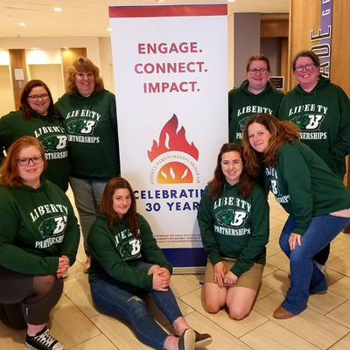
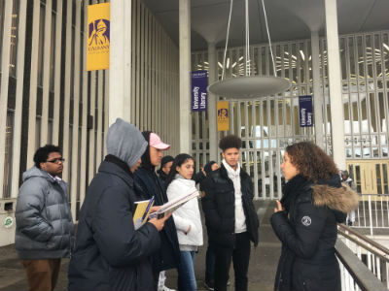
Student Demographics

Slide 9
Gender | Percentage
Male | 42.5%
Female | 57.4%
Non-Binary/Unknown/Not Reported | 0.2%
During 2017-18 LPP served 2,326 more female students than male students.

Slide 10
During 2017-18 there were 15,592 students served by LPP.

Slide 11
During 2017-18 there were 15,640 students served by LPP.

Slide 12
Approximately 66.20% of LPP students (15,592) served were reported as being in Grade 9-13 (10,275).

Slide 13
Reasons Why Students Are Referred to the LPP Program
Each LPP student must have one or more reason for referral.

Slide 14
Reasons Why Students Are Referred to the LPP Program
Each LPP student can have one or more reason for referral. Over 2000 instances of “Other” was used as a primary referral reason- we are not sure what this means and we need clarification. Referral reason missing for 403 students.

Slide 15
LPP programs reported that 61 or less than 1% of the total number of LPP students (15,592) dropped out of school.
During 2017-18 approximately 89.4% of LPP students were either promoted or graduated from the program

Slide 18
During 2017-18 (09/01/17-08/31/18) LPP students (15,592) received an average of 2,215 minutes of LPP intervention minutes or approximately 37 hours of intervention services. Total Service Minutes = 34,546,966

